Slide 1


Infectious Disease Surveillance
MSc Clinical Epidemiology
Ola Adetokunboh MD PhD
Division of Epidemiology and Biostatistics,
Faculty of Medicine and Health Sciences
Stellenbosch University
July 2020

Slide 2
Learning Objectives
To discuss surveillance systems in the context of the global surveillance of infectious diseases
By the end of this session you should be able to:
Define surveillance
Describe different types of surveillance and give examples
Understand the strength and limitations of each type of surveillance
Identify the best surveillance system for infectious disease control
Understand role of sentinel surveillance in the control of infectious disease.

Slide 3
Definition of Public Health Surveillance
The ongoing, systematic collection, analysis, and interpretation of health-related data essential to planning, implementation, and evaluation of public health practice, closely integrated with the timely dissemination of these data to those responsible for prevention and control
Adapted from: Thacker SB, Birkhead GS. Surveillance. In: Gregg, MB, ed. Field epidemiology. Oxford, England: Oxford University Press; 2008.
3
Notes:
Presenter
2019-09-18 13:50:53
-------------------------------------------- SAY:
The term surveillance comes from a French word meaning “to watch over.”
<READ the definition on the slide.> GO to next slide.

Slide 4
Goal of Public Health Surveillance
Provide information that can be used for health action by public health personnel, government leaders, and the public to guide public health policy and programs
Smith PF, Hadler JL, Stanbury M, et al. Blueprint version 2.0: updating public health surveillance for the 21st century. J Public Health Manag Pract 2013;19:231–9.
4
Notes:
Presenter
2019-09-18 13:50:53
-------------------------------------------- SAY:
What is the goal of public health surveillance?
<READ the slide.> GO to next slide.

Slide 5
Uses of Public Health Surveillance
Identify patients and their contacts for treatment and intervention
Detect epidemics, health problems, changes in health behaviors
Estimate magnitude and scope of health problems
Measure trends and characterise disease
Monitor changes in infectious and environmental agents
Assess effectiveness of programmes and control measures
Develop hypotheses and stimulate research
5
Notes:
Presenter
2019-09-18 13:50:53
-------------------------------------------- SAY:
Now that we’ve defined public health surveillance, let’s discuss its role and uses in public health. Here are some specific ways public health surveillance can be used.
<READ the bullets on the slide.> GO to next slide.

Slide 6



Surveillance Process – Data Collection
Data Collection
Data Analysis
Data Interpretation
Data Dissemination
Link to Action
Before collecting data, decide on the overarching goal of the system
What will we monitor?
Who will collect the data, and how will it be collected?
Who is the target population?
6
Notes:
Presenter
2019-09-18 13:50:53
-------------------------------------------- SAY:
Five steps must be completed during the decision-making process, including data collection, analysis, interpretation, dissemination, and follow-up action.
Let’s begin by looking at data collection. Before collecting data, you must decide what the overarching goal of the system is and what specific objectives might be required for meeting that goal. Possible questions to ask might include,
What will we monitor?
Who will collect the data, and how will it be collected?
Who is the target population?
Where do we implement the system?
Will the system be active or passive?
How will the data be transmitted to the person performing the analysis?
GO to next slide.

Slide 7
Data Sources for Public Health Surveillance
Reported diseases or syndromes
Electronic health records (e.g., hospital discharge data)
Vital records (e.g., birth and death certificates)
Registries (e.g., cancer, immunization etc.)
Surveys (e.g., National Health and Nutrition Examination Survey, Demographic and Health Survey etc.)
7
Notes:
Presenter
2019-09-18 13:50:53
-------------------------------------------- SAY:
Surveillance relies on a variety of data sources to monitor different conditions and situations. You might already be familiar with some of the data sources listed on the slide. What are some other data sources used in public health surveillance?
Possible Answers
Administrative data systems (e.g., billing records) Laboratory surveillance (e.g., PulseNet)
Environmental, vector, or animal surveillance (e.g., mosquito trapping for West Nile virus) Other (e.g., pharmacy, laws and policies, or 9-1-1 calls)
GO to next slide.

Slide 8
Who Performs Surveillance?
Epidemiologists
Medical professionals (doctors, nurses, pharmacists, laboratory personnel etc)
Health insurance providers
Emergency responders (emergency management technicians)
Public health departments (local, provincial, national)

Slide 9

Nationally Notifiable Disease Surveillance
The NICD supports the core capacity for surveillance in South Africa.
NICD laboratory-based surveillance covers a number of communicable diseases. such as:
Epidemic-prone diseases
Vaccine-preventable diseases
Disease-targeted for eradication or elimination
Opportunistic infections associated with HIV
Notes:
NICD laboratory-based surveillance covers a number of communicable diseases, such as:
Epidemic-prone diseases, to facilitate early outbreak identification and implement control measures on diseases such as Meningococcal disease, Typhoid, Shigellosis and Viral Hemorrhagic Fevers (VHF).
Vaccine-preventable diseases, to monitor the success of national vaccine programmes and guide priorities in the introduction of new vaccines on diseases such as Polio, Measles, Haemophilus Influenzae and Streptococcus pneumoniae.
Disease-targeted for eradication or elimination, to monitor the quality of clinical surveillance systems in place, and to ensure compliance with international standards for surveillance on diseases such as Polio and Measles.
Opportunistic infections, such as those associated with HIV which have the possibility of creating incorrect statistics related to AIDS-related infections. Infections such as Cryptococcus spp, pneumoniae and invasive Salmonella spp.

Slide 10
Notifiable Medical Conditions in South Africa
NMC are diseases that can result in disease outbreaks with high case fatality rates.
Category 1 - Must be reported within 24 hours of diagnosis.
- Anthrax, Cholera, Diphtheria, Food borne disease outbreak, Malaria, Measles, Pertussis, Plague, Polio, Viral haemorrhagic fever diseases, Yellow fever, Listeriosis, Rabies (human), Smallpox etc.

Slide 11
Notifiable Medical Conditions in South Africa
Category 2 NMC - Must be reported within 7 days of diagnosis.
- Congenital syphilis, Hepatitis (A,B,C,E), Tetanus, TB (pulmonary, extra- pulmonary., MDR-TB,XDR-TB), Leprosy, Tetanus etc.
Category 3 NMC - Must be reported weekly by all public and private labs.
- Ceftriaxone-resistant Neisseria gonorrhoea, West Nile virus, Chikungunya virus, Dengue fever virus etc.
Category 4 NMC -Must be reported monthly by private and public health lab.
- Carbapenemase-producing Enterobacteriaceae, Vancomycin-resistant enterococci, etc.

Slide 12


Surveillance Data Analysis
Data Collection
Who will analyze the data?
What methodology will they use?
How often will they analyse the data?
Data Analysis
Data
Interpretation
Data
Dissemination
Link to Action
Notes:
Presenter
2019-09-18 13:50:53
-------------------------------------------- SAY:
Next we will look at the data analysis step. During this step, we must determine
Who will analyze the data?
What methodology will they use? and
How often will the data be analyzed? Daily, weekly, monthly, or some other timeframe?
Surveillance data analysis usually includes descriptive information consisting of time, place, and person. However, other analytic methods are often used. Let’s look at a few examples.
GO to next slide.

Slide 13
Data Analysis by Person
Do you notice any patterns in the rates?
Demographics for Persons Hospitalized for WNV and Population Rates of Infection
Characteristic | No. of Patients (%) | Population at Risk | Rate of Infection per Million Population
Age (years)
0–19 | 2 (3) | 2,324,081 | 0.9
20–29 | 1 (2) | 1,553,981 | 0.6
30–39 | 3 (5) | 1,549,111 | 1.9
40–49 | 1 (2) | 1,177,190 | 0.8
50–59 | 9 (15) | 867,331 | 10.4
60–69 | 12 (22) | 814,838 | 16.0
70–79 | 18 (31) | 534,785 | 33.7
≥80 | 12 (20) | 281,054 | 42.7
Age category (years)
≥50 | 52 (88) | 2,498,008 | 20.8
<50 | 7 (12) | 6,604,363 | 1.1
Sex
Male | 31 (53) | 4,289,988 | 7.2
Female | 28 (47) | 4,812,383 | 5.8
Race
White | 41 (69) | 5,983,901 | 6.9
Nonwhite | 9 (15) | 3,118,470 | 2.9
Unknown | 9 (15) | -- | --
Borough or county of residence
New York City
Brooklyn (Kings) | 3 (5) | 2,300,664 | 1.3
Bronx | 9 (15) | 1,203,789 | 7.5
Manhattan | 1 (2) | 1,487,536 | 0.7
Queens | 32 (54) | 1,951,599 | 16.4
Staten Island (Richmond) | 0 | 379,999 | 0.0
New York State
Nassau | 6 (10) | 1,287,348 | 4.7
Westchester | 8 (14) | 847,866 | 9.1
Nash D, Mostashari F, Fine A, et al. Outbreak of West Nile virus infection in the New York City area in 1999. N Engl J Med. 2001;344:1807–14.
14
Notes:
Presenter
2019-09-18 13:50:54
--------------------------------------------
<Instructor Note: Walk the participants through the table columns and rows to orient them to the data.>
SAY: Here is an example of data analysis by person. This table displays the demographics for persons hospitalized for West Nile virus and the population rates of infection for a selected period.
ASK: What patterns within the rates, if any, do you notice?
<ELICIT responses from the participants.>
<CLICK to advance animation.>
SAY: You can see that those persons aged 70 years and older have the highest rates of infection.
<CLICK to advance animation.>
You can also see that the cases among males and females were approximately equal, 31 versus 28. However, the rate of infection is slightly higher among males than among females, 7.2 per million versus 5.8 per million. GO to next slide.

Slide 14

Surveillance Data Interpretation
Data Collection
Data interpretation is closely coupled with data analysis
This is about how and why the health event happened
Data Analysis
Data
Interpretation
Data Dissemination
Link to Action
15
Notes:
Presenter
2019-09-18 13:50:54
-------------------------------------------- SAY:
The next step in the surveillance process is data interpretation, which is closely coupled with data analysis. By identifying the person, place, and time, you can more easily determine how and why the health event happened.
GO to next slide.

Slide 15


Data Dissemination
Data Collection
Health agency newsletters, bulletins, or alerts
Surveillance summaries and reports
Medical and epidemiologic journal articles
Press releases and social media
Data Analysis
Data Interpretation
Data
Dissemination
Link to Action
16
Notes:
Presenter
2019-09-18 13:50:54
--------------------------------------------
SAY:
Data dissemination describes how to distribute information to those who need to know.
Methods of distribution include
health agency newsletters, bulletins, or alerts; surveillance summaries and reports;
medical and epidemiologic journal articles; and press releases and social media.
Let’s look at the target audience for each of these dissemination methods. GO to next slide.

Slide 16
Data Dissemination Target Audiences
Public health practitioners
Clinicians and other health care providers
Policy and other decision makers
Community organizations
The general public
17
Notes:
Presenter
2019-09-18 13:50:54
-------------------------------------------- SAY:
Target audiences can include
public health practitioners,
clinicians and other health care providers, policy and other decision makers, community organizations, and
the general public.
Providing feedback to those who report the data is crucial because it improves the acceptability of the surveillance system, and data reporters are more likely to cooperate if they know their efforts are being tabulated, analyzed, and used.
GO to next slide.

Slide 17


Surveillance Link to Action
Data Collection
Data Analysis
Public health surveillance should always have a link to a specific public health action
Data Interpretation
Data Dissemination
Link to Action
18
Notes:
Presenter
2019-09-18 13:50:54
-------------------------------------------- SAY:
Link to action is the final and a required step in the public health surveillance process because, without action, the collected data serve no real purpose. GO to next slide.

Slide 18
Types of Public Health Surveillance
Passive
Active
Syndromic
Sentinel

Slide 19
Passive Surveillance
The use of local healthcare services to collect data on disease incidence or drug adverse effects.
Laboratories, physicians, or others regularly report cases of disease or death to the local or state health department.
Inexpensive.
Provider-initiated.
Good for monitoring large numbers of typical health events.
Most common type of surveillance in humanitarian emergencies

Slide 20
Passive Surveillance
Poor data quality - under-reporting is a problem
Health authorities do not stimulate reporting by reminding health care workers to report disease nor providing feedback to individual health workers
Examples:
A doctor’s office reports 2 cases of measles
A nursing home reports an unusual number of older patients with unexplained rashes

Slide 21
Active Surveillance
Local or state health departments initiate the collection of information from laboratories, physicians, health care providers, or the general population
Good for detecting small numbers of unusual health events
Achieves more complete and accurate reporting than passive surveillance
Provides stimulus to health care workers in the form of individual feedback or other incentives
Reporting frequency by individual health workers is monitored
Health workers who consistently fail to report or complete the forms incorrectly are provided specific feedback to improve their performance

Slide 22
Active Surveillance
More expensive
Health Department-initiated
Requires substantially more time and resources and is therefore less commonly used in emergencies
Challenges with human capital
Example:
Youth Risk Behavior Surveillance surveys

Slide 23
Syndromic Surveillance
Syndromic surveillance uses health-related data that precede diagnosis and signal a sufficient probability of a case or an outbreak to warrant further public health response
New syndromes may emerge that present in an atypical manner
Focuses on one or more symptoms (especially the chief complaint) rather than a physician-diagnosed or laboratory-confirmed disease
Example:
In cases of anthrax, a syndromic surveillance system might detect a surge in influenza-like illness, thus, providing an early warning and a tool for monitoring an ongoing crisis

Slide 24
Sentinel Surveillance
Sentinel surveillance could be active or passive
A sentinel surveillance system selects a small group of health workers from whom to gather data.
Used when high-quality data are needed about a particular disease that cannot be obtained through a passive system.
This involves reporting units with a high probability of identifying cases, good laboratory facilities, experienced staff who identify and notify on certain diseases.
Unlike passive surveillance, a sentinel system deliberately involves only a limited network of carefully selected reporting sites.

Slide 25
Sentinel Surveillance:
System definition
Limited case ascertainment area
Comprised of selected hospitals and laboratories out of all possible facilities
Traditionally includes largest hospitals in geographic area
Should do pre-evaluation to select appropriate sentinel sites

Slide 26
Sentinel Surveillance:
Key Advantages
Can easily collect individual patient-related data
Less costly and burdensome on resources
Flexible system design
Useful for documenting trends

Slide 27
Sentinel Surveillance:
Key disadvantages
May require significant financial investments in personnel and resources
Data may have biased or skewed findings
Data is not generalizable to geographic population
Does not collect incidence data

Slide 28
Criteria for selecting a sentinel site
The following criteria should be considered in selecting a sentinel health facility (usually a general or infectious disease hospital) :
It should be willing to participate
Serves a relatively large population that has easy access to it
It has medical staff sufficiently specialised to diagnose, treat and report cases of the disease under surveillance
High-quality diagnostic laboratory
Previous reports of high prevalence
Exposure to high-risk individuals
Suspected concentration of high-risk groups

Slide 29
Sentinel System Example:
HIV sentinel groups
Men having sex with men/bisexual
Commercial sex workers
Returning overseas workers
Intravenous drug users
Males at STD clinics
Other groups

Slide 30
HIV Sentinel Surveillance:
Major products
The identity and location of the core transmitters (reservoirs) of HIV
Trends of prevalence in risk groups, the surrogates of the general population and geographic areas (spread)
Trends in incidence
Estimates that can be used for “advocacy” messages to recruit support and educate the public
Estimates of the number, location and characteristics of HIV-infected and AIDS cases that can be used to anticipate future needs to cope with the epidemic

Slide 31
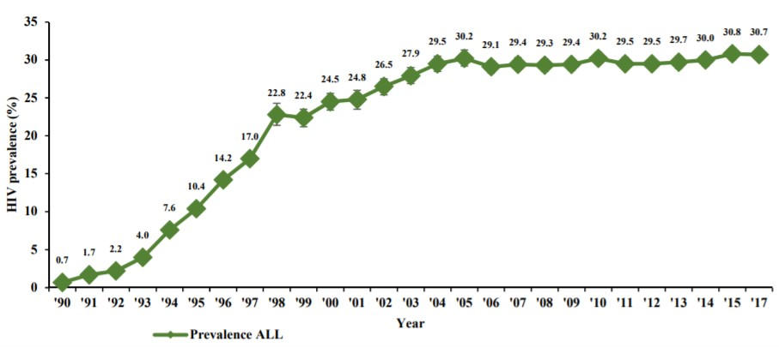
The HIV epidemic curve among antenatal women, South Africa, 1990 to 2017
National Antenatal Sentinel HIV & Syphilis Survey Report, 2019

Slide 32
Group for Enteric, Respiratory and Meningeal Diseases Surveillance in South Africa (GERMS-SA)
GERMS-SA is a robust national laboratory-based population surveillance program for HIV-associated bacterial and fungal opportunistic infections
The main objective of this programme is to provide information regarding trends in the burden of HIV-associated opportunistic infections
Organisms and diseases under surveillance include:
HIV,AIDS, and TB: epidemiology of rifampicin-resistant TB, cryptococcal meningitis, invasive pneumococcal disease, non-typhoidal salmonellosis
Child mortality reduction: contribute to the collection of information related to vaccine-preventable diseases (invasive pneumococcal disease and Haemophilus influenzae)
Hospital services: improve quality of care in hospitals through aiding to reduce hospital-acquired infections (candidaemia, Staphylococcus aureus and Klebsiella spp).
iii.

Slide 33
Group for Enteric, Respiratory and Meningeal Diseases Surveillance in South Africa (GERMS-SA)
The GERMS platform receives case reports and isolates from about 200 microbiology laboratories and report approximately 18,000 OI cases annually.
Additionally, GERMS has significantly contributed to the development of clinical guidelines for various IDs in SA.
GERMS quarterly and annual reports are published for dissemination by the National Institute for Communicable Diseases – a division of the National Health Laboratory Service.

Slide 34
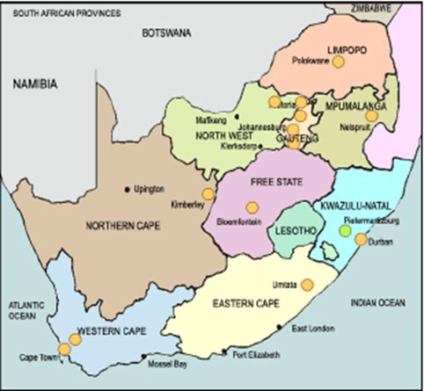
GERM-SA sites

Slide 35
Electronic Tuberculosis Register
ETR.Net is an electronic tuberculosis register designed for TB/HIV surveillance, program monitoring and evaluation.
It was developed to provide more efficient and useful collection, compilation, and analysis of TB data on an ongoing basis.
ETR.Net is designed to:
Capture patient-based information at the district level directly from paper TB registers
Generate standard cohort reports, line listings and data quality checks which reflect WHO DOTS Strategy
Enable staff to monitor and evaluate TB programs

Slide 36
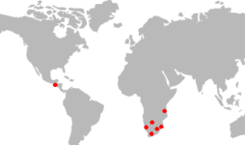
Electronic Tuberculosis Register
ETR.Net has been introduced, tested or implemented in the following countries:
Botswana
Guatemala
Mozambique
Namibia
South Africa
Swaziland
Tanzania

Slide 37
Global Surveillance Systems
WHO division known as the Global Health Observatory (GHO) compile data on the state of health around the world
GHO collects data by censes, surveys, and vital registration systems
Centers for Disease Control and Prevention (CDC) Global Disease Detection (GDD) Program operates via WHO regional centres
The centres are responsible for disease surveillance and response in their respective areas
The regional centres are interconnected via the Global Outbreak Alert Response Network (GOARN), and they report to the GDD operations centre at CDC headquarters in Atlanta
GDD responds to high-profile public health events such as Ebola, polio eradication, MERS-CoV, cholera, Nipah virus etc.

Slide 38
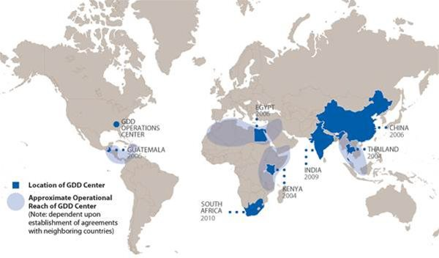
Location of CDC GDD Centers

Slide 39
Global Surveillance Systems
International Society of Infectious Diseases (ISID) surveillance programs gather and share vital information amongst the international ID community.
The following are some of the ISID surveillance partnership:
The Program for Monitoring Emerging Diseases (ProMED): An internet- based reporting system dedicated to the rapid global dissemination of information on outbreaks of IDs and acute exposures to toxins
Mapping the risk of international infectious disease spread (MRIIDS): Tool to estimate and visualize risks posed by outbreak events
EpiCore: An innovative ID surveillance program dedicated to enabling faster verification of outbreaks around the globe
iii.

Slide 40
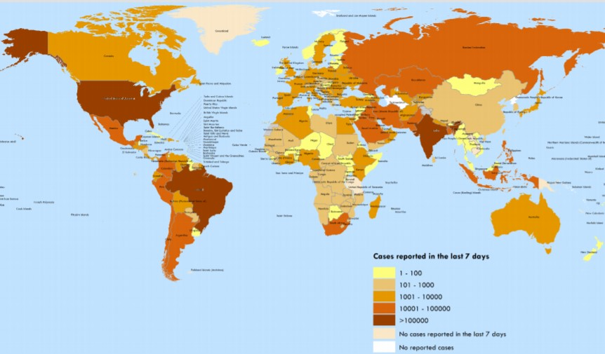
Situation Report (WHO)
Number of confirmed COVID-19 cases reported in the last seven days by country, territory or area, 5July to 11 July

Slide 41
Disease outbreak news (WHO)
Middle East respiratory syndrome coronavirus (MERS-CoV) – Saudi Arabia
2 July 2020
Between 1 April and 31 May 2020, the National IHR Focal Point of Saudi Arabia reported nine new cases of MERS-CoV infection, including five deaths.
Ebola virus disease – Democratic Republic of the Congo
26 June 2020
On 25 June 2020, the Minister of Health of the Democratic Republic of the Congo declared the end of the Ebola Virus Disease (EVD) outbreak in North Kivu, Ituri and South Kivu Provinces .

Slide 42


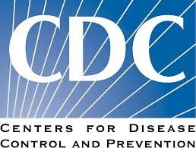

Acknowledgment

